Slide 1
Subscription Tracker Interim
Luke Hallinan

Slide 2
Overview
The aim of this project is to create a web application to track a users subscription services
It will give the user information about their active subscriptions
As well as statistics for spending
Find forgotten subscriptions
Use data to generate recommendations

Slide 3
Why
Popularity
In the last 5 years the subscription market has grown by over 100%
Most common are media services that 46% of online shoppers were shown to use
Costs
On average consumers underestimated how much they were spending by 2.5 times
Forgotten
42% of people have services that they forgot they are even subscribed too

Slide 4

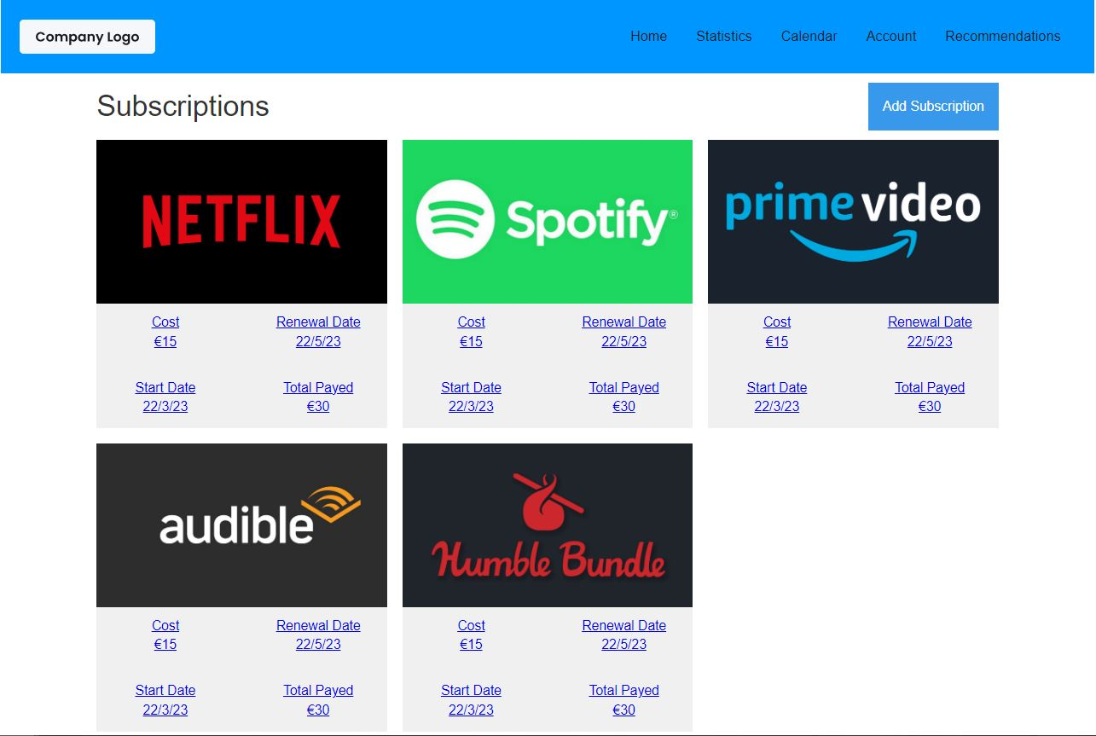

Slide 5
Technologies
JavaScript, HTML, CSS
Express JS
Node.JS
PostgreSQL
Docker

Slide 6
System Architecture
Architecture
Database
The application uses the Model View Controller architecture
Split into client, server and database
PostgreSQL database
Running on docker containers

Slide 7
Research
Current Technologies
Some popular applications are TrackMySubs, Rocket Money and Trim
Each has a different way of functioning
Common Features
Current subscriptions / bills page
Monthly spending / budgeting page
Calendar of upcoming payments
Cancel subscriptions
Alerts for next payments (email / text)
Manually added subscriptions

Slide 8
Requirements Capture
Include common functionality
Persistent data storage
Complete site
Subscription importing
Data analytics

Slide 9
Project Complexity
Website and Database
Base complexity from website and database interactions
Finding Subscriptions
Using an excel exported bank statement to search for and import subscriptions
Data Analytics
Data gathered will be used for recommending users other services
Data can also be used for marketing purposes

Slide 10
Project Management
Agile methodology selected
Weekly supervisor meetings
Weekly logs
GANTT chart tracking – report

Slide 11
Prototype
Prototype
Future
Functioning front end, backend and database
Hard coded mock information
Connection client through server to database
Populated site from database
Redirect to login if needed
Subscription imports
Data anylitics

Slide 12
Demo
Demo of site progress
I will now walk though a demo of the current web application progress
Parts
Different pages
Suggested functionality
Recommendations
Database connections log

Slide 13
Thank You Any Questions?

